Slide 1

Financial & Risk Analytics Capstone Project
SUBMITTED BY :- VARAD ANAND

Slide 2
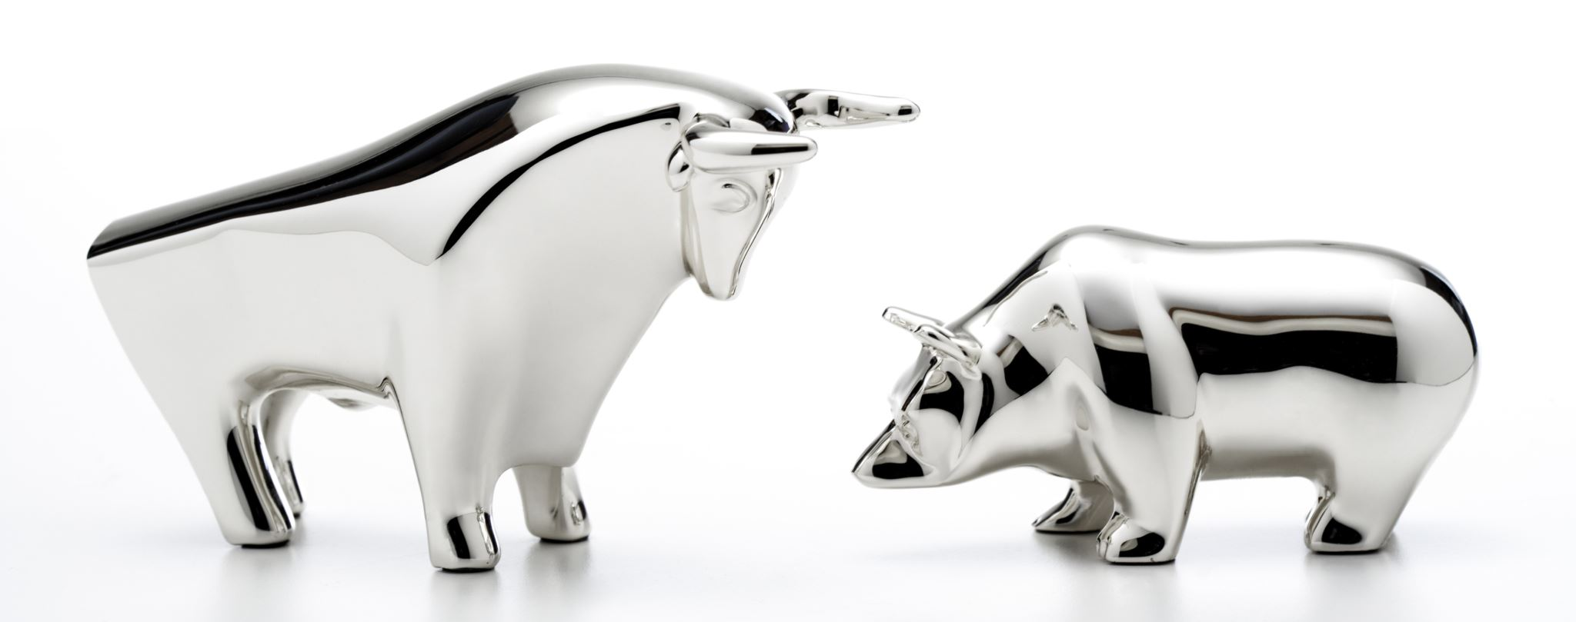
Bull & Bear A bull market occurs when securities are on the rise, while a bear market occurs when securities fall for a sustained period.

Slide 3

Problem Statement

Slide 4
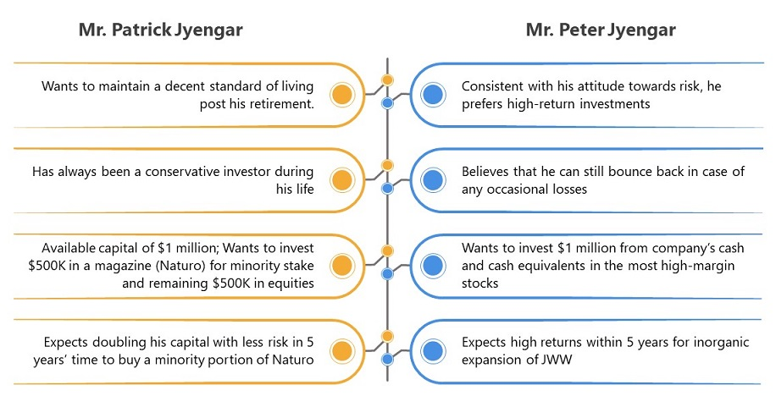
In the recent past, the industry of wealth management has seen a lot of growth. Every individual or business actively searches for opportunities to get the maximum returns. However, in most of the cases, they either lack the skills to identify the right investment opportunity, or there is a shortage of time for finding these opportunities. Hence, this gave rise to the dedicated individuals who perform this task on behalf of the investors for a commission - Portfolio managers.
A portfolio manager makes investment decisions and carries out other related activities on behalf of vested investors. They work with a team of analysts and researchers, and their main objective is to realize the needs of the investor and suggest a suitable portfolio that meets all the expectations. They are responsible for establishing the best investment strategy, selecting appropriate investments along with the right allocation. However, in doing so, they face a lot of competition in the form of other portfolio managers and rival firms. Therefore, the portfolio manager has to use the available resources to provide the best solution to the investor.
Consider yourself working for an associate at an investment firm that manages accounts for private clients. Your role requires you to analyse a portfolio of stocks to provide consultation on investment management based on client’s requirement.

Slide 5
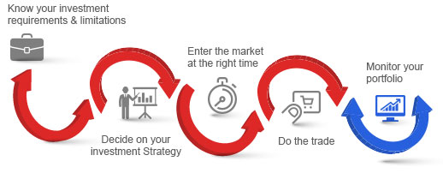

Slide 6

Graphs

Slide 7

Summary Statistics & Line Plots of Cumulative Returns

Slide 8
Coef_variation or Coefficient of Variation represents the risk ratio mean and Std Deviation of daily returns i.e. stock with least coef_variation value has low risk and hence has low return or is a worst stock. But stocks having high coef_variation value implies high risk with high return value or is a best performing stock. Std or Standard Deviation more risky stocks will have more std values while stocks with less risk will have less std values.
STATISTICAL WORDS

Slide 9
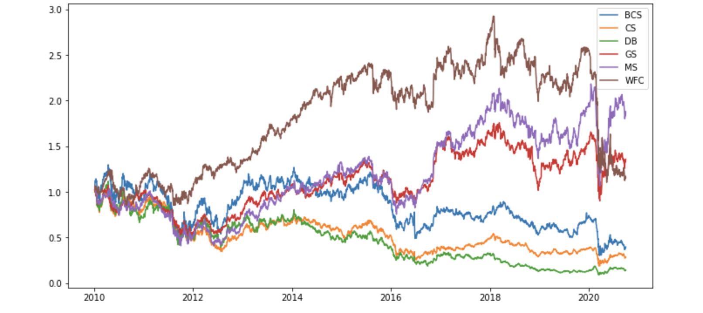
Finance Stocks
We can see for Finance industry the Cumulative Return for the span of 10 years shows that stocks like `GS, MS and WFC` haven't performed well with cumulative return range between 1% to less than 3%.
 | BCS | CS | DB | GS | MS | WFC
mean(returns) | -8.16E-07 | -0.00021 | -0.00037 | 0.000285 | 0.000488 | 0.000222
std(volatility) | 2.60E-02 | 0.022302 | 0.026494 | 0.018517 | 0.022633 | 0.018308
reward to risk ratio | -3.13E-05 | -0.00951 | -0.01397 | 0.015404 | 0.021578 | 0.012126

Slide 10
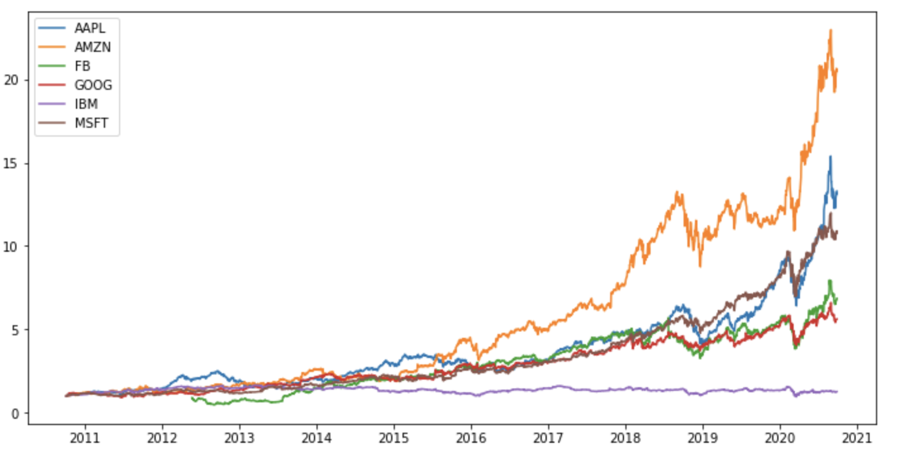
Technology Stocks
Technology industry stocks have highest Cumulative return for last 10 years with range of 1 % to more than 25%, except the `IBM` stock with cumulative return of just 1% for 10 years.
 | AAPL | AMZN | FB | GOOG | IBM | MSFT
mean (returns) | 0.001185 | 0.001398 | 0.001189 | 0.000818 | 0.000189 | 0.001079
std (volatility) | 0.017705 | 0.019889 | 0.023569 | 0.016288 | 0.01411 | 0.016084
reward to risk ratio | 0.066957 | 0.07027 | 0.050453 | 0.050194 | 0.013429 | 0.067072

Slide 11
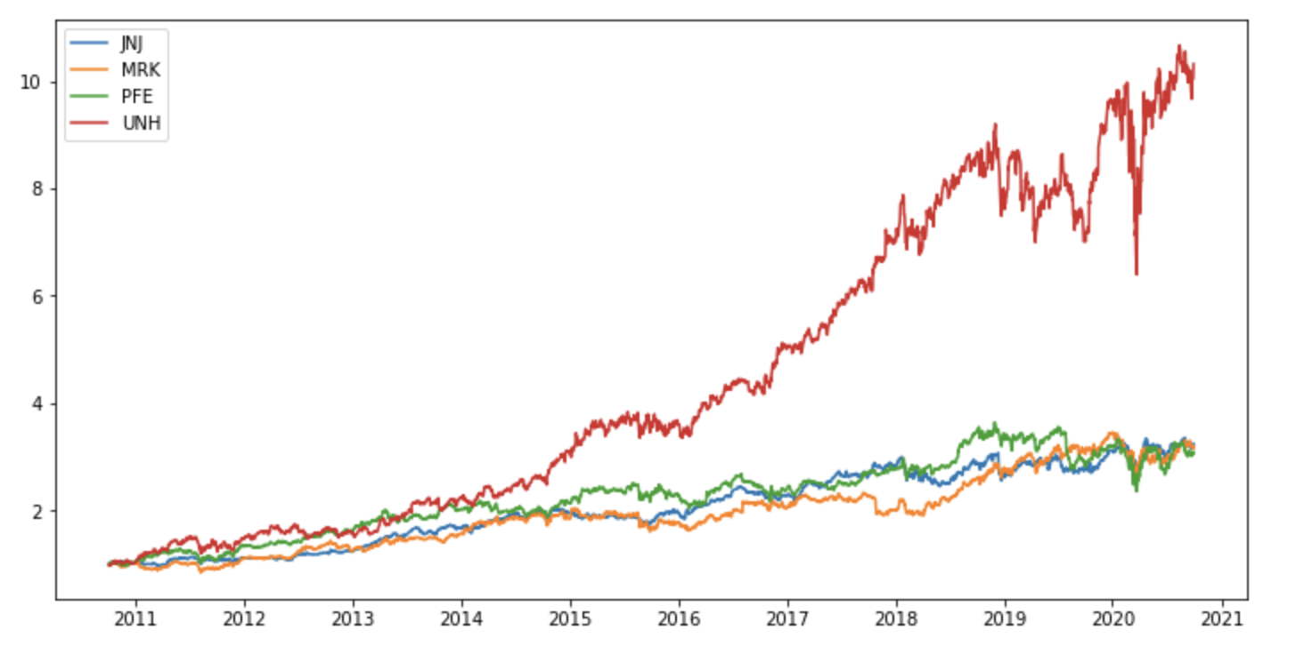
Health Stocks
In Healthcare industry, the only well performing stock is `UNH` with cumulative range. between1% to more than 11% otherwise other stocks have cumulative range below 3%.
 | JNJ | MRK | PFE | UNH
mean(returns) | 0.000526 | 0.000545 | 0.000527 | 0.001063
std(volatility) | 0.010811 | 0.01301 | 0.012563 | 0.016427
reward to risk ratio | 0.048629 | 0.041883 | 0.041918 | 0.064717

Slide 12
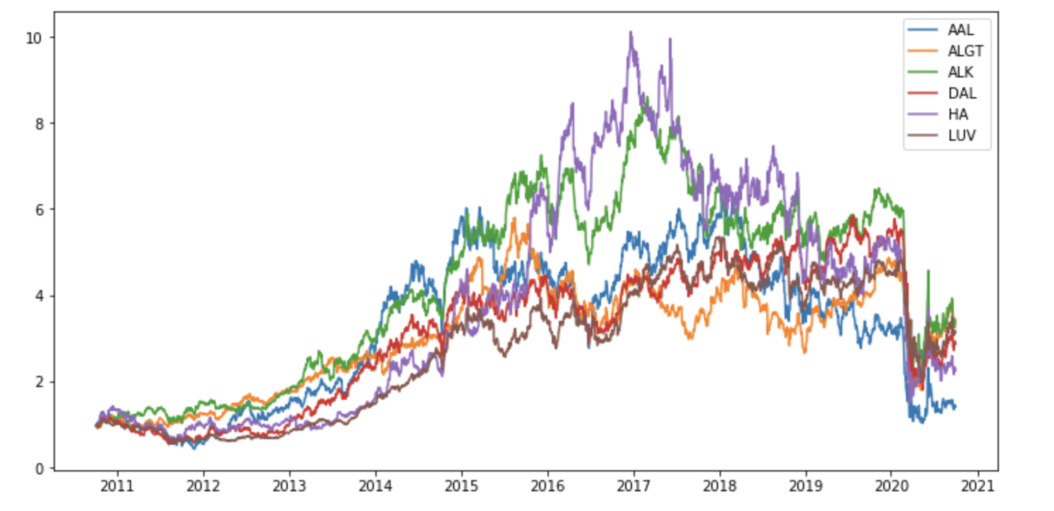
Aviation Stocks
In Aviation industry the cumulative return movesbetween 1% to 10% for span of a decade.
 | AAL | ALGT | ALK | DAL | HA | LUV
Mean(returns) | 0.00066 | 0.000775 | 0.00076 | 0.000747 | 0.00078 | 0.000663
Std(volatility) | 0.032723 | 0.024578 | 0.023567 | 0.025529 | 0.030147 | 0.020477
Reward to risk ratio | 0.020176 | 0.031525 | 0.032238 | 0.029267 | 0.025871 | 0.03236

Slide 13
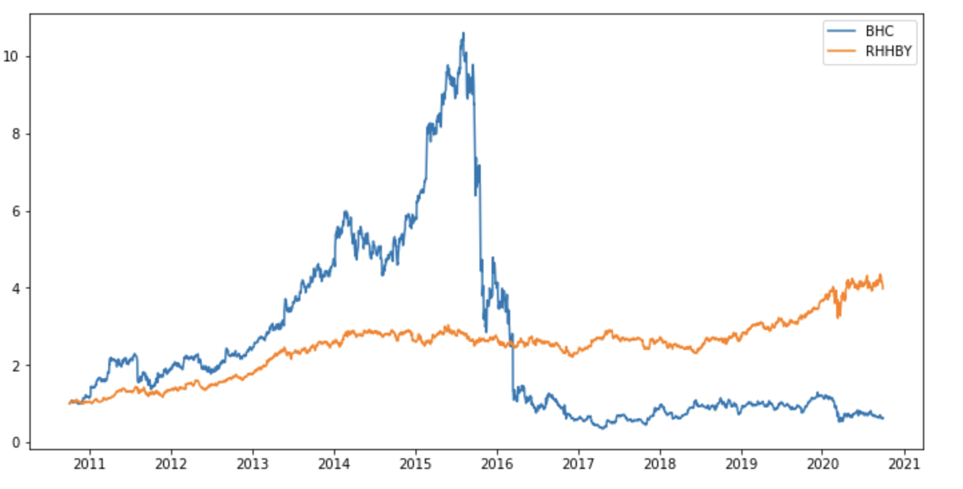
Pharmaceuticals Stocks
For Pharmaceuticals industry the cumulative return ranged from 1% to 10% till halve of 2015 but after sudden drop in other halve of 2015 it ranged from 1% to just 4%
 | BHC | RHHBY
mean(returns) | 0.00048 | 0.000637
std(volatility) | 0.035703 | 0.013274
reward to risk ratio | 0.013442 | 0.047951

Slide 14
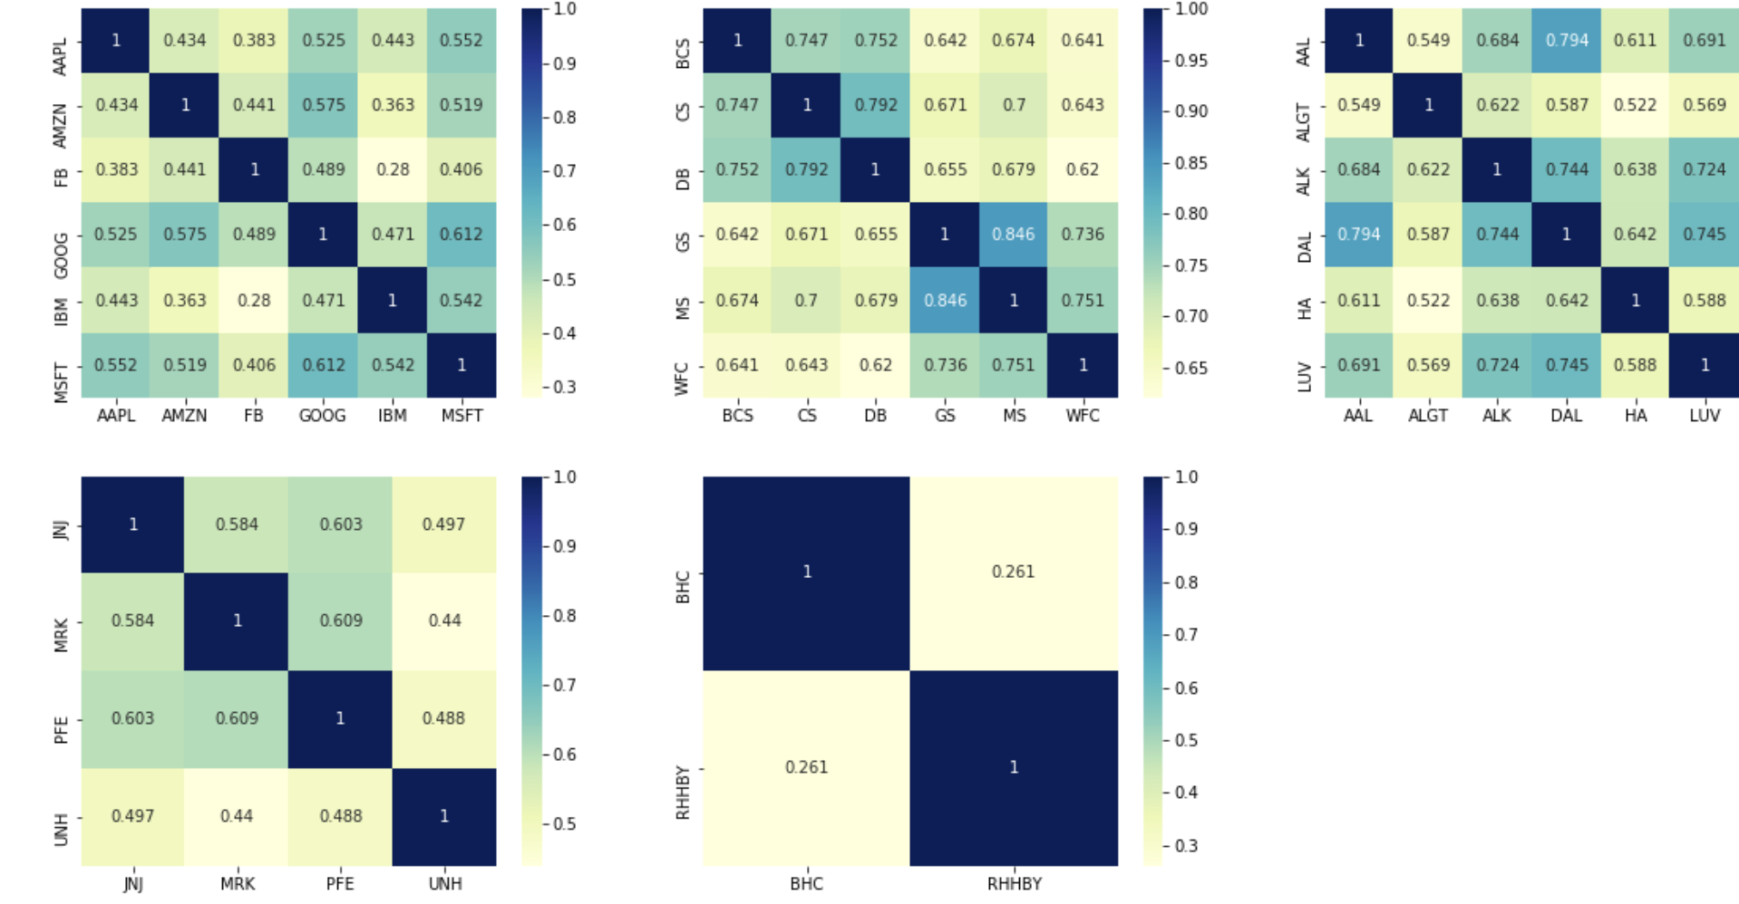
Heatmap Subplot

Slide 15

Portfolio

Slide 16
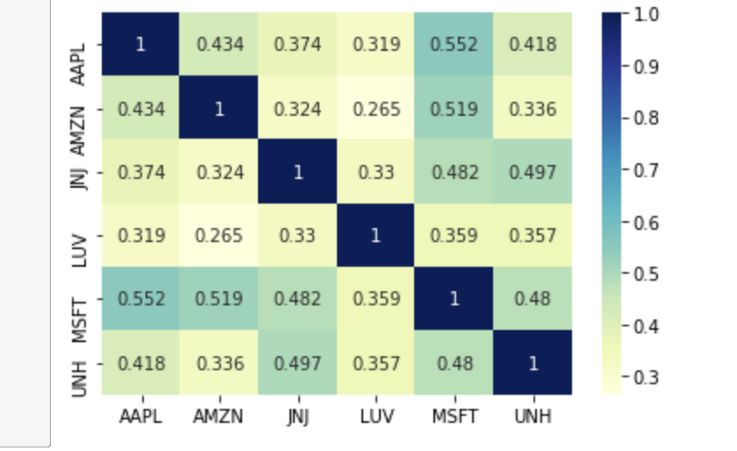
Patrick - low risk conservative, wants a good retirement life Since patrick prefers less risk and consistent returns we will select stocks which have less volatility(std) We will also diversify our portfolio to all sectors so that we don’t have all our eggs in one basket Technology - Amazon, Microsoft and Apple will be considered Amazon has the best reward to risk ratio and Microsoft is the second best and Apple is third Health - JNJ & UNH will be considered Aviation - LUV & ALK, but since they are very much correlated, we will skip ALK and consider only LUV Finance & Pharms - No stocks are being considered because of not satisfactory performance
Portfolio of Patrick

Slide 17
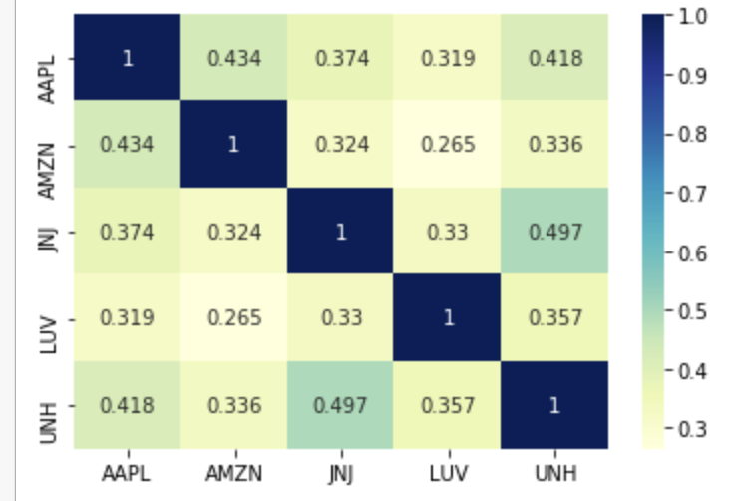
Final Portfolio of patrick after removing of MSFT because MSFT was showing high correlation with some of other stocks in portfolio

Slide 18
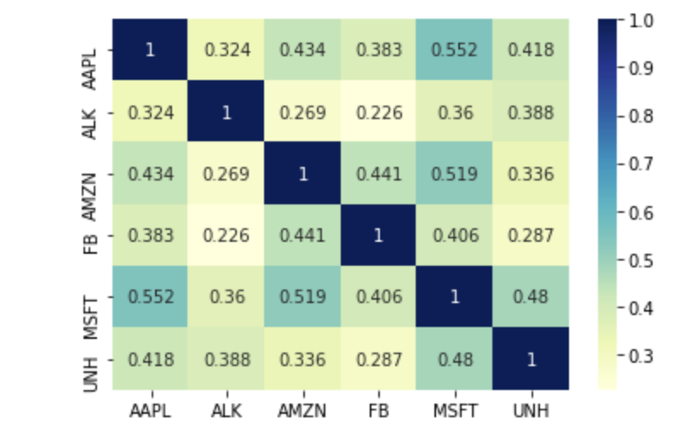
Since peter wants high returns and is willing to take high risks we can select stocks which are giving superior returns Even though we will do portfolio diversification, but we will not be as strict as it was in the case of Patrick Here we can afford to have less restriction on correlation, but we will still be a little careful Technology - almost all tech stocks are really having good cumulative returns so we will select, - we will select, AMZN, AAPL, MSFT, FB Health - UNH will be considered Aviation - ALK, Finance & Pharms - No stocks are being considered because of not satisfactory performance
Portfolio of Peter

Slide 19
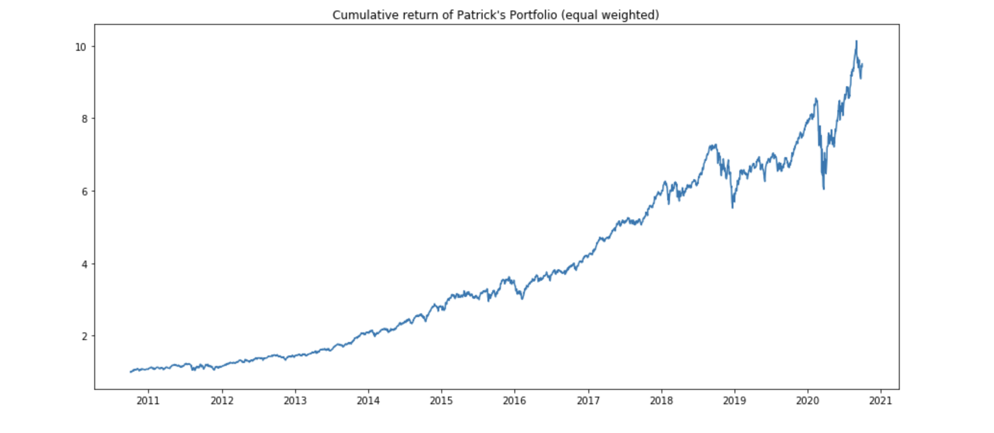
Cumulative return of Patrick's Portfolio
1. Patrick - low risk conservative, wants a good retirement life
2. Since patrick prefers less risk and consistent returns we will select stocks which have less volatility(std)
3. We will also diversify our portfolio to all sectors so that we don’t have all our eggs in one basket
4. Technology - Amazon, Microsoft and Apple will be considered
5. Amazon has the best reward to risk ratio and Microsoft is the second best and Apple is third
6. Health - JNJ & UNH will be considered
7. Aviation - LUV & ALK, but since they are very much correlated, we will skip ALK and consider only LUV
8. Finance & Pharms - No stocks are being considered because of not satisfactory performance

Slide 20
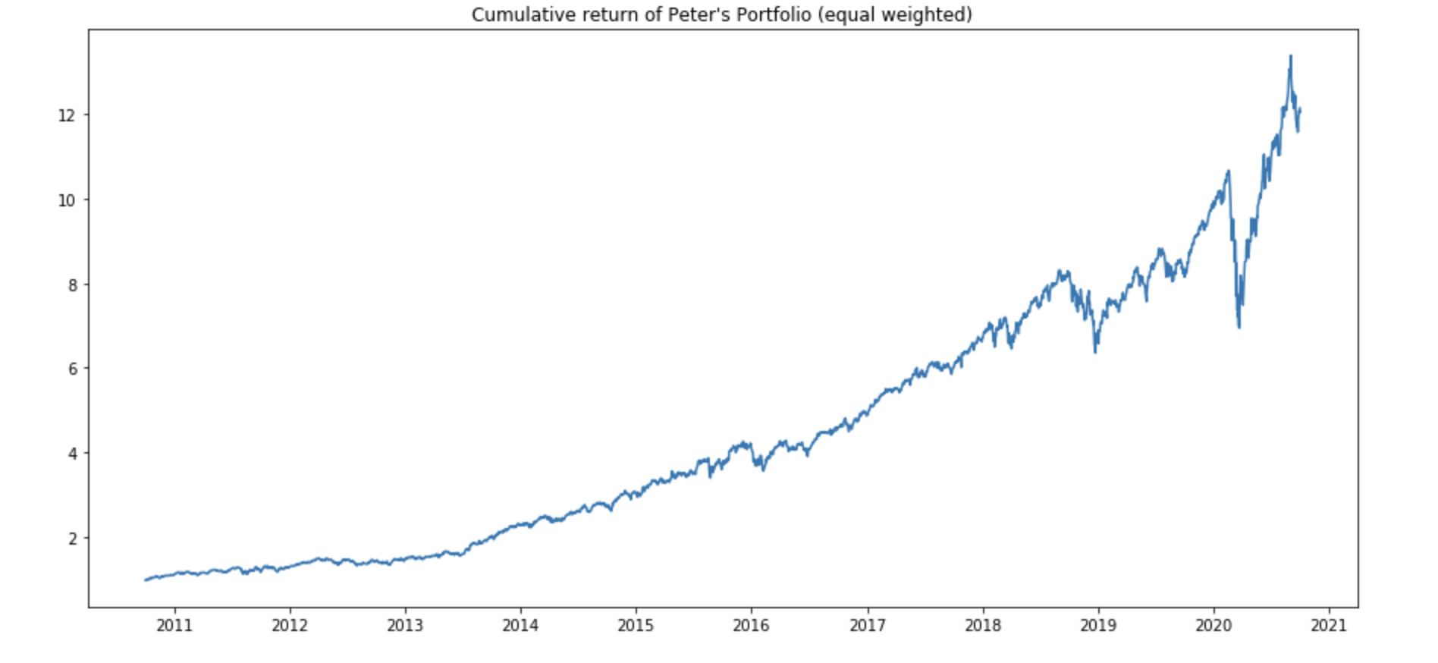
Cumulative return of Peter's Portfolio
1. Since peter wants high returns and is willing to take high risks we can select
2. stocks which are giving superior returns
3. here we can afford to have less restriction on correlation, but we will still be a little careful
4. Technology - almost all tech stocks are really having good cumulative returns so we will select,
5. we will select, AMZN, AAPL, MSFT, FB
6. Health - UNH will be considered
7. Aviation - ALK,
8. Finance & Pharms - No stocks are being considered because of not satisfactory performance

Slide 21
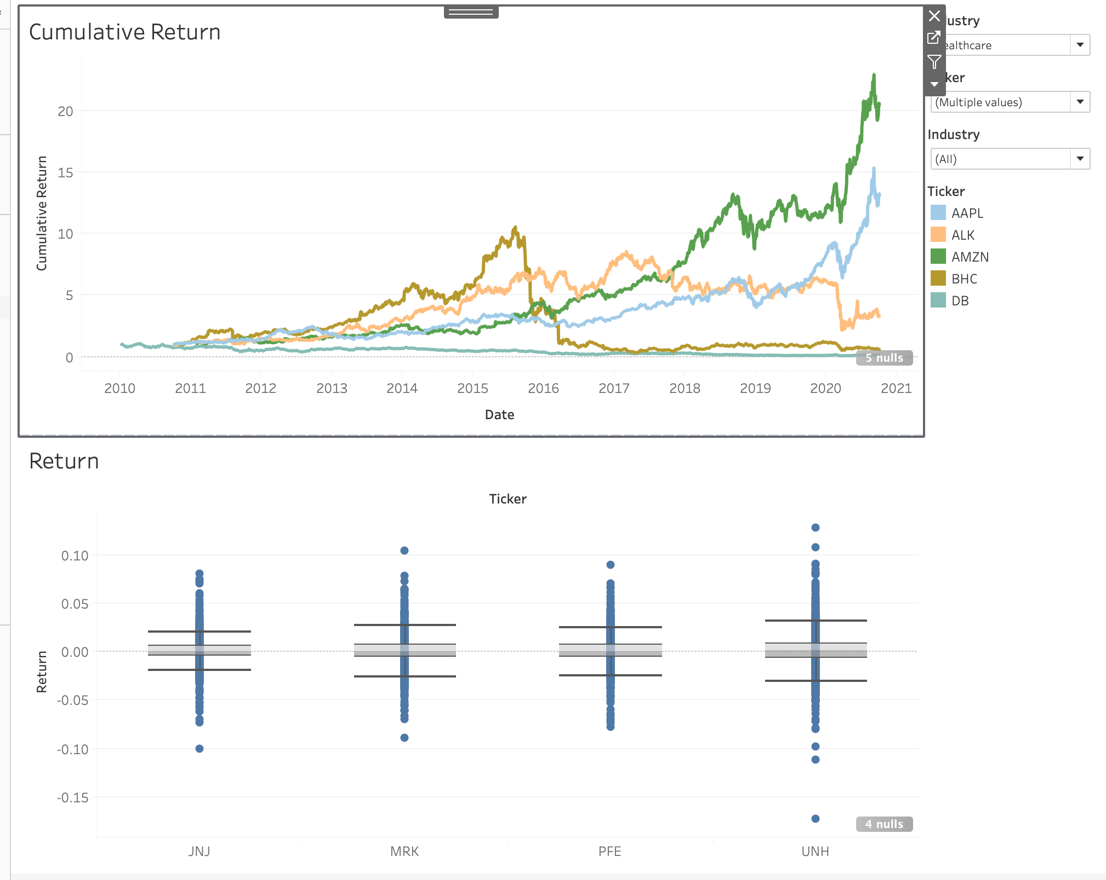
Dashboard made on Tableau

Slide 22


